Slide 1
Standard User – Contracts Editor Features: Executive Summary
June, 2013

Slide 2

Learning Objectives
Upon completion of this course you will be able to:
View the Executive Summary
Customize the Executive Summary

Slide 3
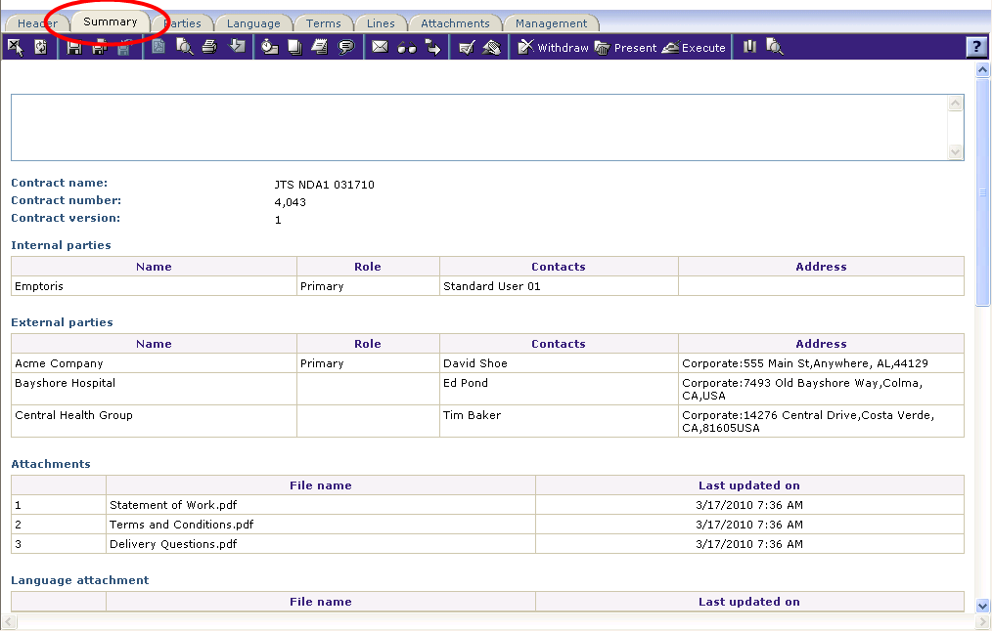
The Executive Summary
The Executive Summary provides a single place to view key elements of a contract.
It contains several sections that describe or summarize the Terms, Language and Management or Lifecycle changes for a contract instance.
The content of each summary may be customized or modified (with permissions) to display specific information about the contract.
The Summary may be printed or emailed to others.
Customers love the Summary but usually don't know what they want included until Acceptance Test.

Slide 4
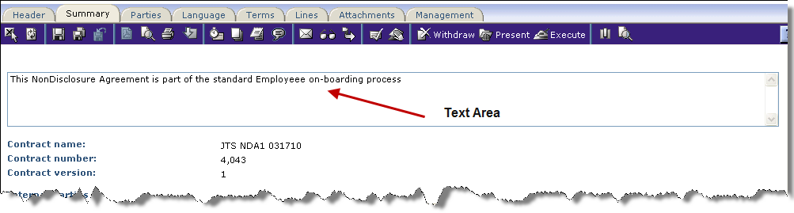
Summary Text Area
Enter any business critical text information to accompany the Summary data.
This should be a comprehensive synopsis that explains the key elements and what is important about this contract. For example:
  Description of contract and important terms
  Who reviewed this contract
  What compensation methods are involved
  Sourcing information and reviews
  Summary of the Scope of Work
  etc.

Slide 5
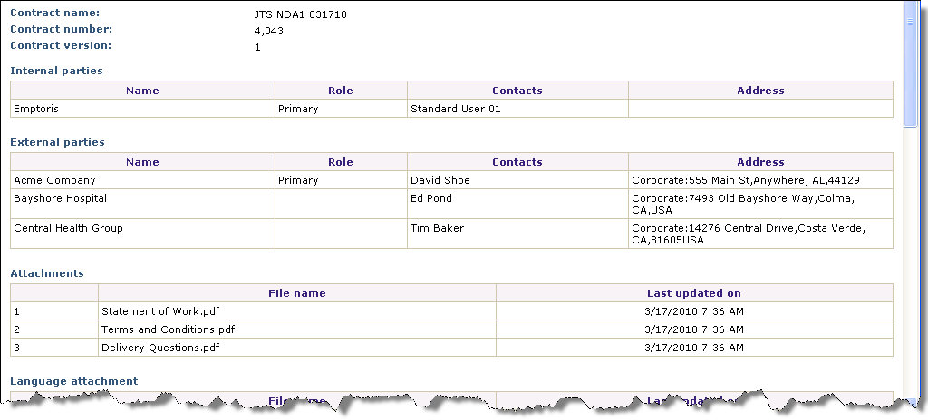
Summary Sections
The Executive Summary is configurable and may contain a wide variety of information. Common sections include:
  Parties: Internal and External
  Terms
  Attachments
  Relationships
  Activity (separate sections
  for Review, Approvals,
  Status Changes, etc.)
  Task Delegation
  Negotiations
  Modified Language Clauses
  (with or without the Language)

Slide 6
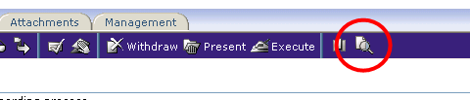

Preview Executive Summary
Click the Print Preview icon to view the Executive Summary document.
The Executive Summary can be configured or customized to display specific information about a contract.
Click the Configure Contract Summary icon.

Slide 7
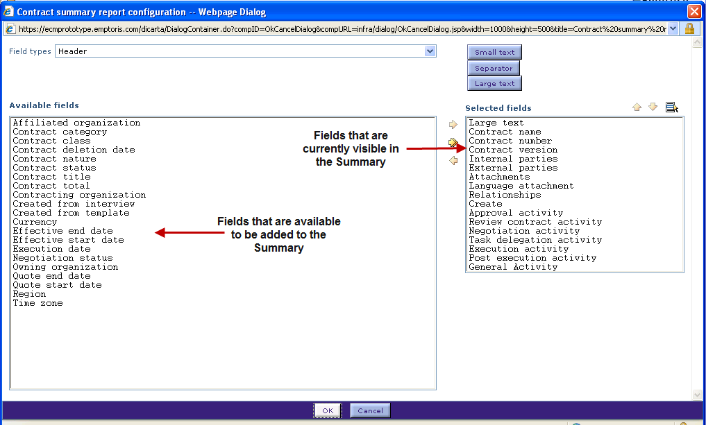
Customize the Executive Summary
To select a field, click to highlight the field in the Available Fields list on the left.
Click the right arrow to move the field to the Selected Fields list on the right.
To remove a field from the visible Summary, select the field from the Selected Fields list on the right side, and use the left arrow icon to remove the field to the Available Fields on the left side.

Slide 8
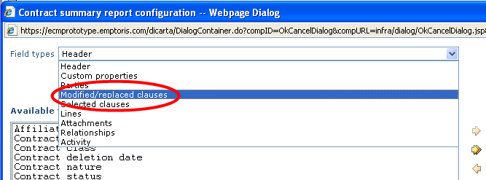
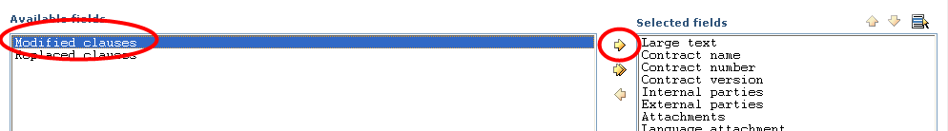
Customize the Executive Summary, cont.
Select different Field Types from the drop down menu to view the available fields on the left panel, as shown in the example above.
    Note that one Field Type value is “Lines”, which is particularly useful to include as of V10.0.1, given the added Lines functionality.
Click the right arrow icon to move the field to the Selected Fields list on the right.

Slide 9
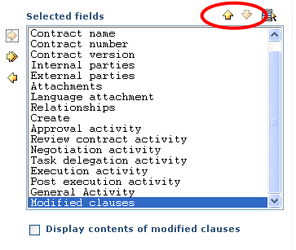
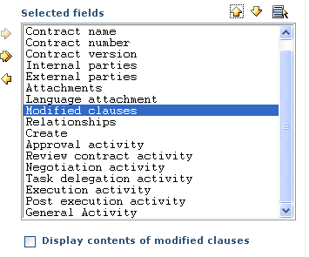
Customize the Executive Summary, cont.
Click the Up and Down arrow icons to position the new field in the list.

Slide 10
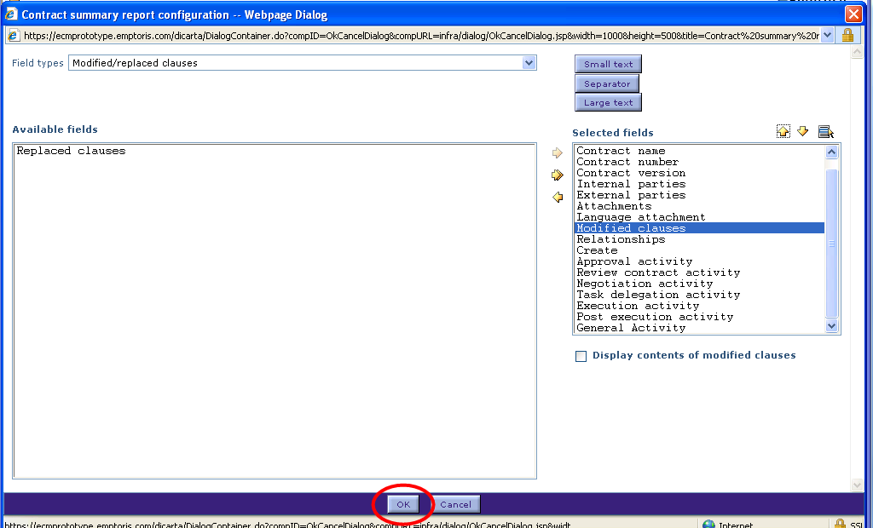
Customize the Executive Summary, cont.
Continue adding or removed fields as appropriate.
Click OK when done.

Slide 11
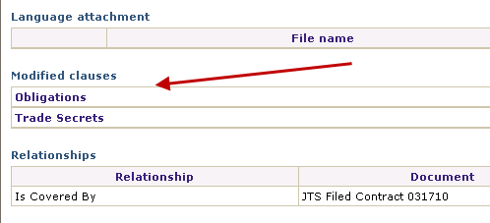
Customize the Executive Summary, cont.
The reconfigured sections are displayed in the Summary.

Slide 12

Questions?

